Slide 1

INTRODUCTION
LOAN PORTFOLIO ANALYTICS & CREDIT OPTIMIZATION REPORT

Slide 2
BUSINESS REQUIREMENT
Objective
Data Walkthrough & Quality Check in Power Query
Data Connection using ETL Process
Data cleansing, sorting, filtering and analyzing data in SQL
Writing Queries in Postgre SQL
Data Modelling and Processing
Pivot Tables Calculations in Excel
Report Lay outing and Insights Generation
Dashboard

Slide 3
OBJECTIVE
Comprehensive Loan Analysis:
These dashboards are designed to provide an in-depth analysis of bank loan performance by summarizing key metrics, such as total applications, funded amounts, and success rates. They enable precise identification of trends in good versus bad loans, state-wise distributions, and term-based categorization to guide strategic financial decision-making.
Optimized Decision-Support Framework:
By leveraging advanced visualizations, these dashboards facilitate real-time monitoring of critical KPIs, including attrition rates, interest rates, and customer preferences. This empowers stakeholders to improve operational efficiency, reduce financial risk, and align business strategies with emerging market insights.

Slide 4
DASHBOARD SPECIFICATION
KPI’s Requirements :
Total Loan Applications (38.6K)
Represents the total number of loan applications processed within a specified time frame. Includes Monthly-To-Date (MTD) and Month-over-Month (MoM) growth percentages.
Total Funded Amount ($435.8M)
Reflects the total amount of loans disbursed to customers. It also highlights MTD and MoM trends in funding performance.
Good Loan Issued (86.2%)
Indicates the percentage of loans classified as "good" based on predefined criteria (e.g., repayment likelihood, low risk).
Bad Loan Issued (13.8%)
Shows the percentage of loans classified as "bad," which may carry higher risks or are more likely to default.

Slide 5
DASHBOARD SPECIFICATION
KPI’s Requirements :
Good Loan Applications (33.2K)
The number of loan applications categorized as "good," contributing to financial stability.
Bad Loan Applications (5.3K)
The number of loan applications classified as "bad," which could signal areas requiring improved credit risk assessments.
Loan Applications by Status (Fully Paid, Charged Off, Current)
Breaks down the loan statuses, showcasing how many loans have been paid, are in default, or are still active.
Funded Amount and Amount Received
Visualizes the total disbursed loan amounts and the corresponding repayments received.

Slide 6
CHART REQUIREMENTS
Good vs. Bad Loan Pie Chart
A pie chart splits the loan data into "Good Loans" and "Bad Loans," illustrating the proportions visually (86.2% vs. 13.8%).
Loan Applications by Purpose (Bar Chart)
Displays the breakdown of loans by purpose, such as credit card, home, debt consolidation, educational loans, etc.
Highlights the most common reasons for borrowing, aiding in demand analysis.
Loan Applications by State (Map Visualization)
A geographical heat map identifies the distribution of loan applications across states.
Darker shades indicate higher loan application volumes.
Loan Applications by Term (Donut Chart)
Breaks down loan applications into terms, such as 36 months vs. 60 months, providing insights into borrower preferences.

Slide 7
CHART REQUIREMENTS
Loan Applications by Home Ownership (Bar Chart)
Analyzes applications based on homeownership status, dividing them into categories like mortgage or rent.
Loan Applications by Month (Line Chart)
Tracks the monthly volume of loan applications, highlighting seasonal trends or growth over the year.
Interest Rate and DTI (Bar Chart)
Compares the interest rate and Debt-to-Income (DTI) ratio across different loan grades or categories.
Helps identify risk areas or trends in borrower affordability.

Slide 8
ANALYSIS & FINDINGS
Loan Performance Segmentation:
The dashboard identifies a significant proportion (86.2%) of loans as "Good Loans," reflecting effective screening mechanisms, while 13.8% of loans are classified as "Bad Loans," emphasizing areas for improvement in risk assessment.
Geographical Insights:
State-wise loan application distribution highlights key regions driving loan demand, enabling the bank to prioritize resources and marketing efforts in high-growth areas.
Loan Purpose and Duration Trends:
Analysis of loan applications by purpose reveals a high preference for credit card loans and debt consolidation, while term-based segmentation shows a majority opting for 36-month terms, indicating customer behavior trends.
Financial Metrics Optimization:
Metrics such as a total funded amount of $435.8M against $473.1M applications showcase operational efficiency in approving high-value loans, while monitoring bad loan funded amounts ($65.5M) reveals a need for enhanced risk mitigation strategies.
Month-on-Month Growth:
The dashboard reports a consistent month-over-month growth in loan applications (6.9%), signifying a healthy increase in customer engagement and demand for banking products.

Slide 9
RECOMMENDATIONS
Optimize Loan Approval Strategies:
Focus on improving the risk assessment framework to reduce the proportion of bad loans (currently at 13.8%) by incorporating advanced credit scoring models and predictive analytics.
Target High-Growth Regions:
Allocate marketing and operational resources to states with the highest loan application volumes to capitalize on regional demand and drive further growth.
Diversify Loan Products:
Expand offerings for loan purposes such as educational and renewable energy loans, which currently show lower application volumes, to tap into emerging customer needs.
Refine Interest Rate Policies:
Use insights from the interest rate analysis to customize rates for different loan grades and purposes, improving affordability and increasing customer retention.
Enhance Loan Duration Flexibility:
Introduce new loan terms or modify existing ones to accommodate diverse customer preferences beyond the popular 36-month term.
Strengthen DTI Evaluation:
Tighten debt-to-income ratio thresholds for high-risk applicants to reduce default probabilities, while maintaining competitive lending standards.
Leverage Month-over-Month Growth Insights:
Develop targeted campaigns to sustain the current 6.9% month-over-month growth, ensuring continued customer acquisition and engagement.

Slide 10
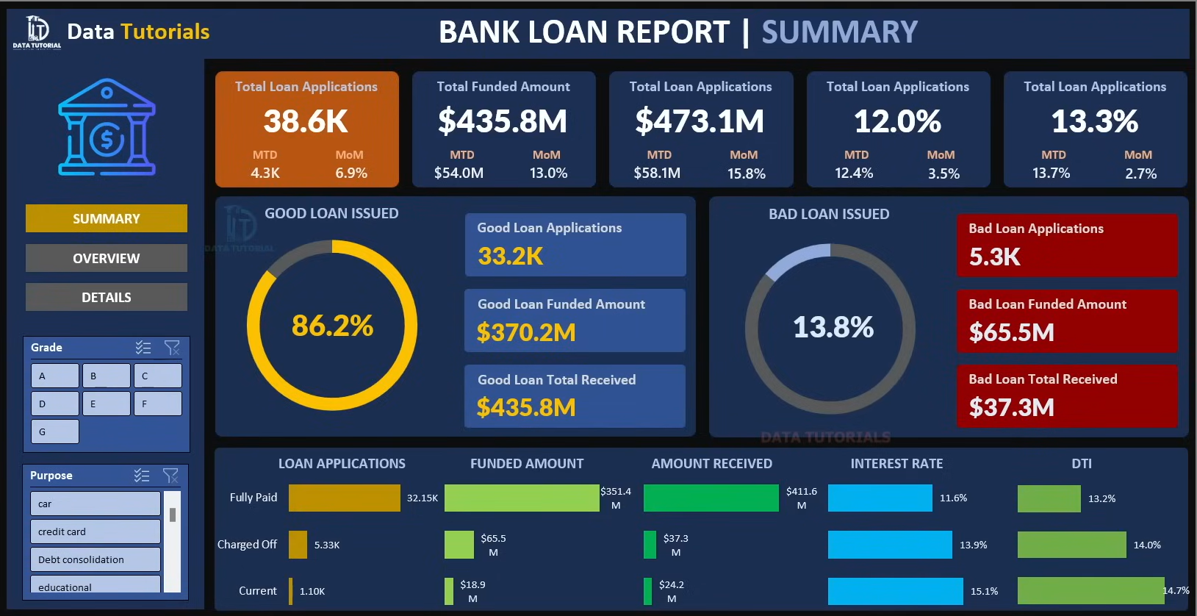
DASHBOARD

Slide 11
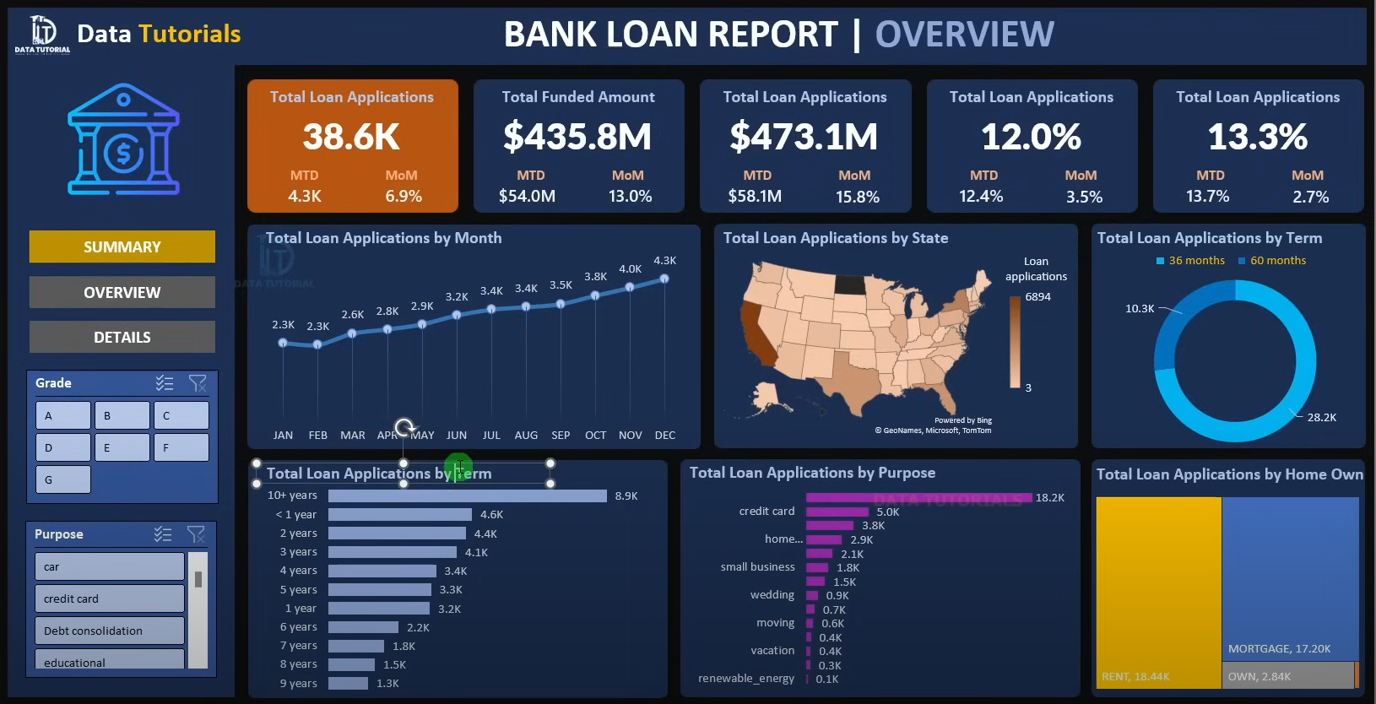
DASHBOARD

Slide 12
THANK YOU

